Slide 1
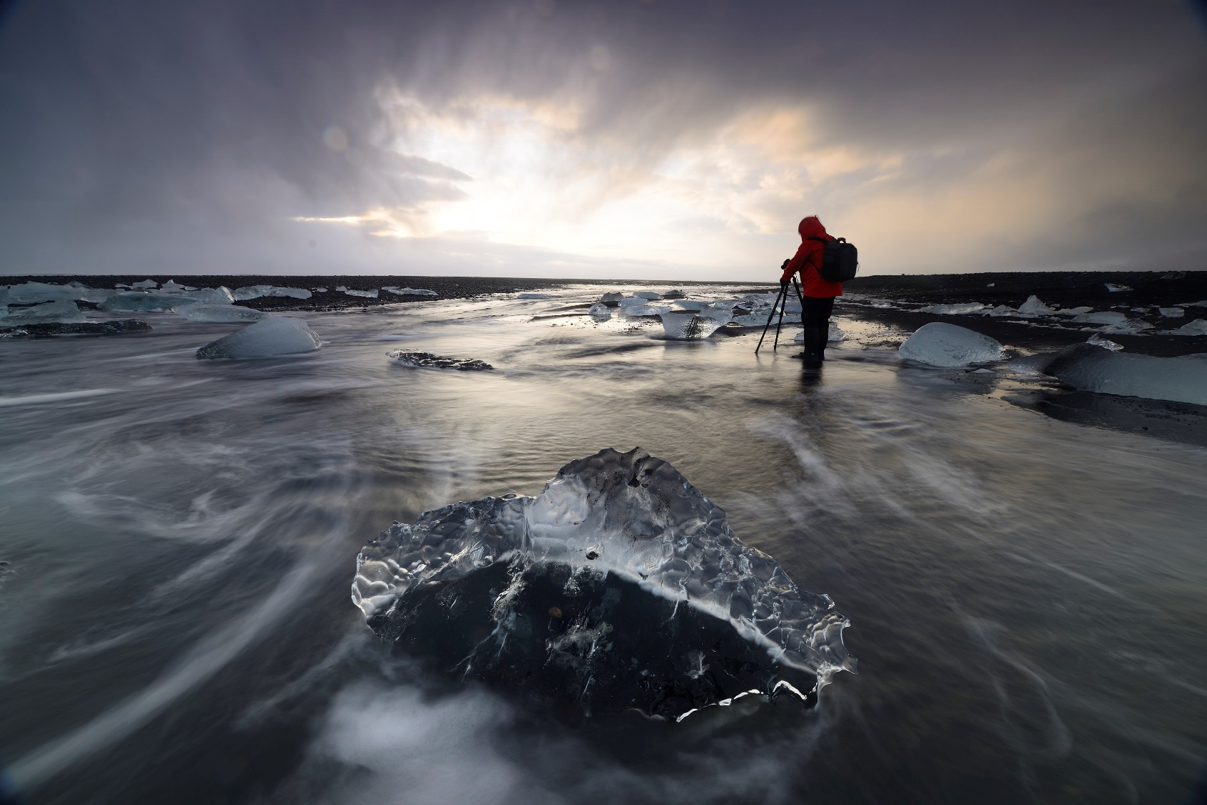
Jack Graham Photography…
A “What’s it All About Production”
©Jack Graham Photography LLC/ All Rights Reserved / All Images made using Fujifilm Cameras and Fujinon Lenses v91210169_

Slide 2
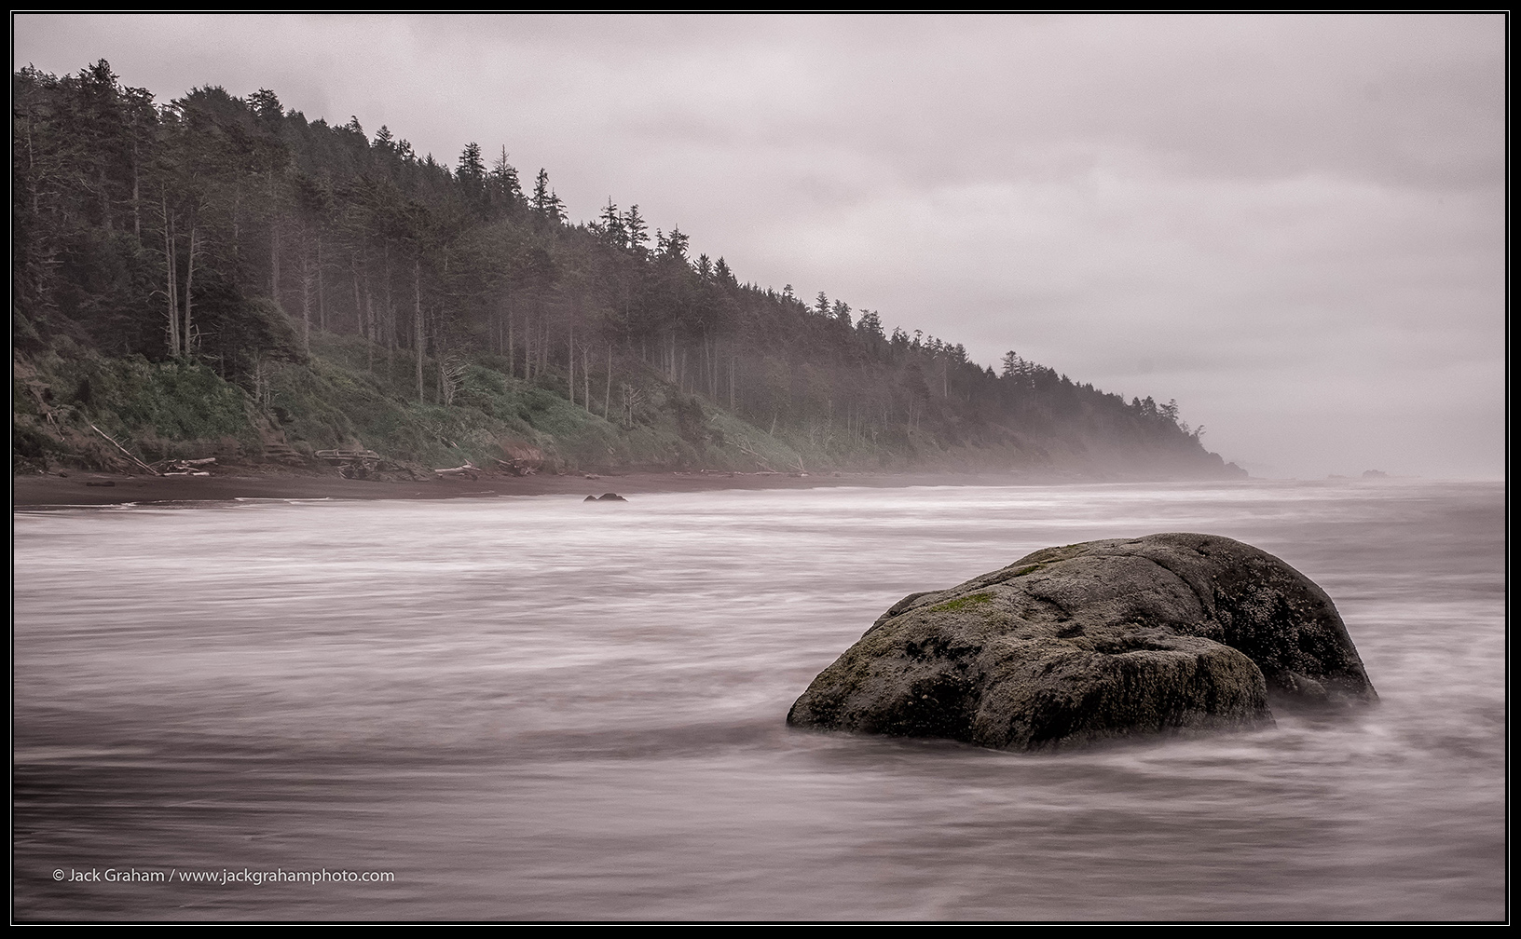
“BECOME an ARTIST…… NOT JUST A PHOTOGRAPHER”
© Jack Graham Photography LLC /All Rights reserved

Slide 3
Photography is a form of language that is a way to communicate information and meanings.
Convey your subjective thoughts and feelings through photographs, rather than your images being records of things we see and find interesting
Many so called “Artists” work in a very calculated and formatted way to achieve what they term “success”. This stymies creativity
Expressive “ART” reflects the life of the artist with all life’s ups and downs

Slide 4
The world doesn’t need more photographs. It needs photographs that reveal something and invoke a feeling, that touch us on some level

Slide 5
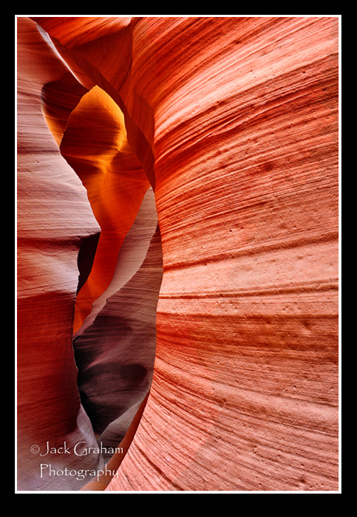

Slide 6
WHY DO I PHOTOGRAPH?..WHAT A GREAT QUESTION!
….Photography is a form of CREATIVE EXPRESSION. This (creativity) has been my life.
….Photography allows me to inject my own feelings and personal thoughts within the experience. Photography is my way of communicating outwardly, of “saying” things to other people
….Photography lets me share my feelings and experiences with others in a meaningful way
….Photography let me have the freedom of self expression as part of my job( HOW COOL IS THAT!!!!!)
…. Photography lets me to live a life that is satisfying and meaningful to me.
…. Photography also allows me to connect with others who may relate to my work and to my experiences. ….Thanks to Photography…I have made my best friends in this world.
…. a means of sharing my experiences with an audience.
….I love where I live thanks to Photography and on and on

Slide 7
“I DON’T CARE ABOUT THE IMAGES”
Photographs, to me, are not my ultimate goal; they are byproduct of my experiences
experiences
I also care more about the “Art of making the image” than the image itself.
Rather, I feel like personalizing a place—and making the location or subject more meaningful….Having a relationship with either the place or subject… CAN BE AMAZINGLY REWARDING….. Leaving photography totally out of the equation.
I also care more about the “Art of making the image” than the image itself.
WHEN YOU HAVE THIS RELATIONSHIP WITH A PLACE AND EXPERIENCES:
Your life is better for it
Your creations will be inspired by it. AND……
YOU WILL MAKE IMAGES THAT………
Are not just aesthetic pleasing, but also expressive
That convey not just aesthetic pleasing images, but also images that have a part of you in them (what makes these places special and meaningful to you.)
This kind of expressive work makes for more satisfying, and better, ART… than just a beautiful trophy.

Slide 8
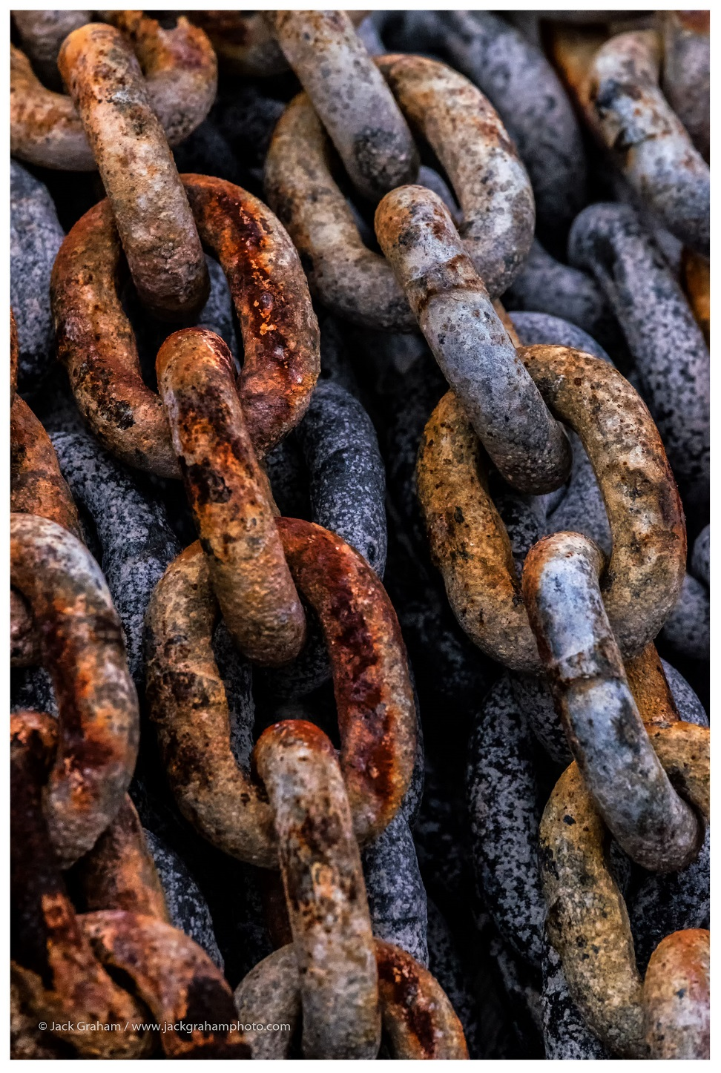
REMEMBER……………….YOU ARE THE ONLY ONE WHO HAS TO LIKE THE IMEGE

Slide 9
A SENSE OF PLACE
Develop a relationship with a place, your life will be better for it.
Your creations will be inspired by it. This will allow you to make photographs that are not just aesthetic, but also expressive and personal and why this place is meaningful to you.
You images will be more satisfying, artistic and personal, rather than just another trophy shot. trophy

Slide 10
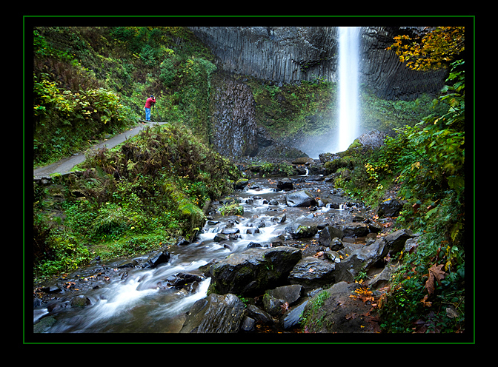

Slide 11
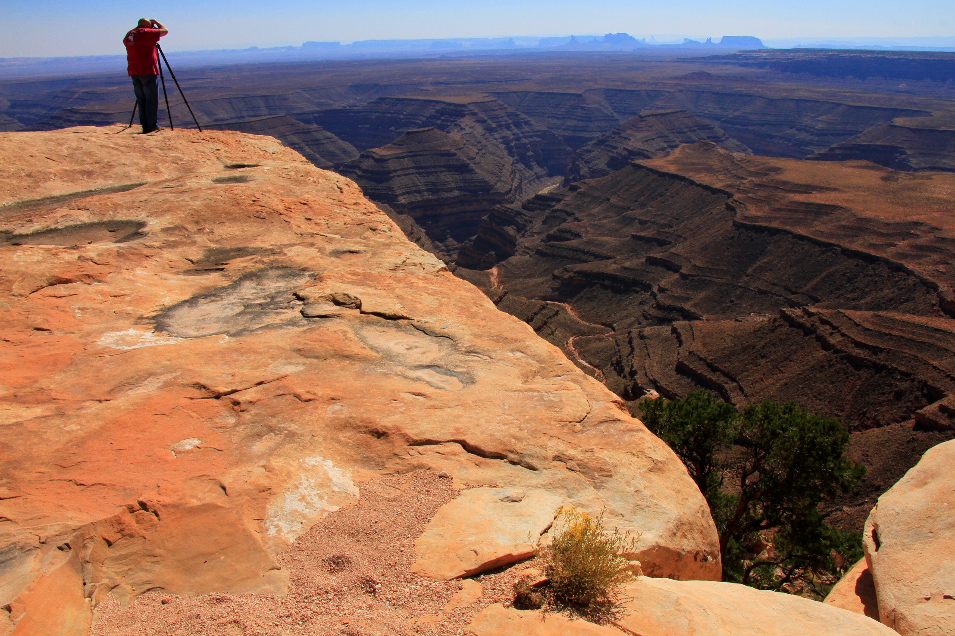

Slide 12
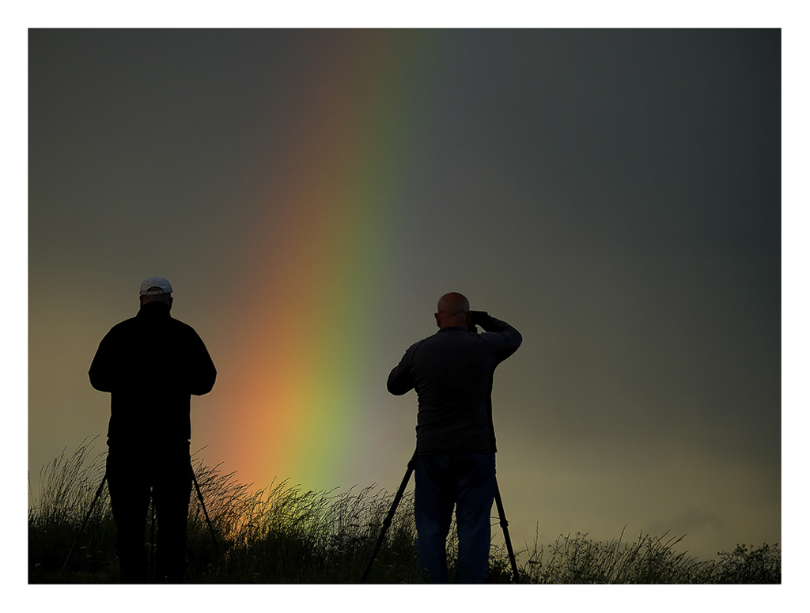

Slide 13
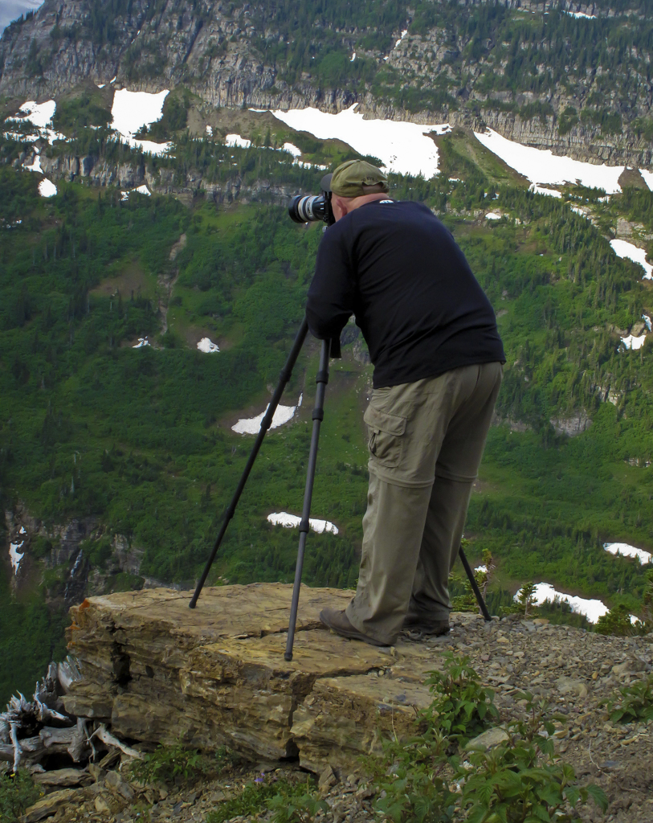
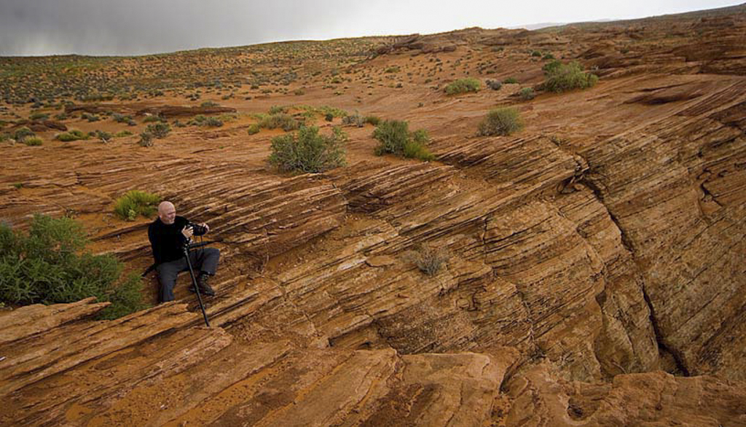

Slide 14
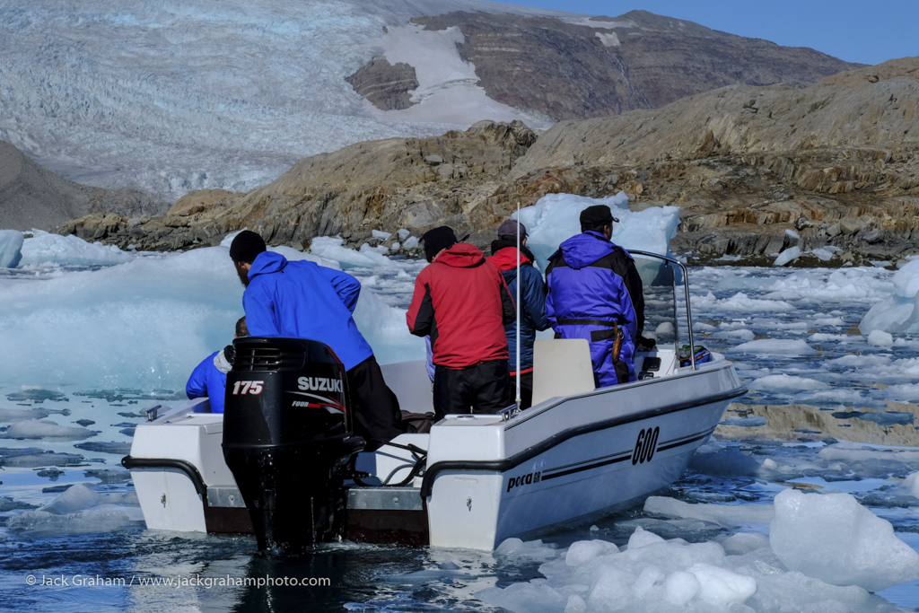

Slide 15
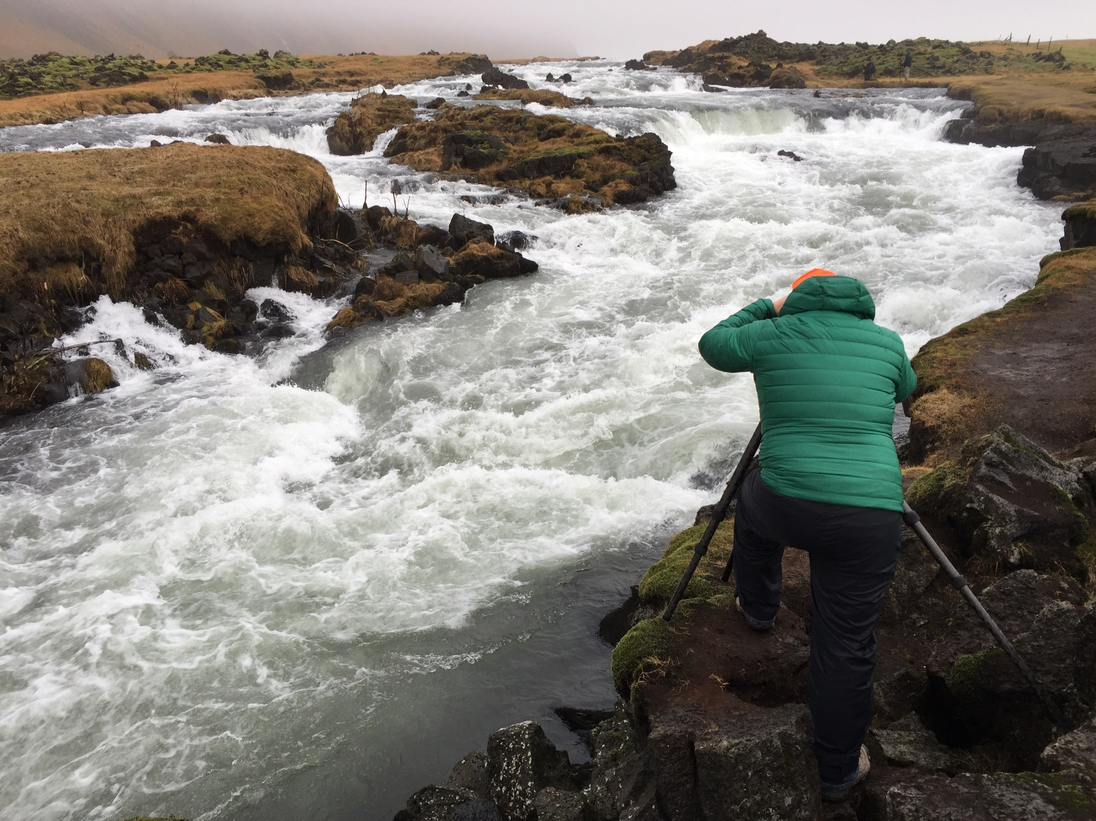

Slide 16
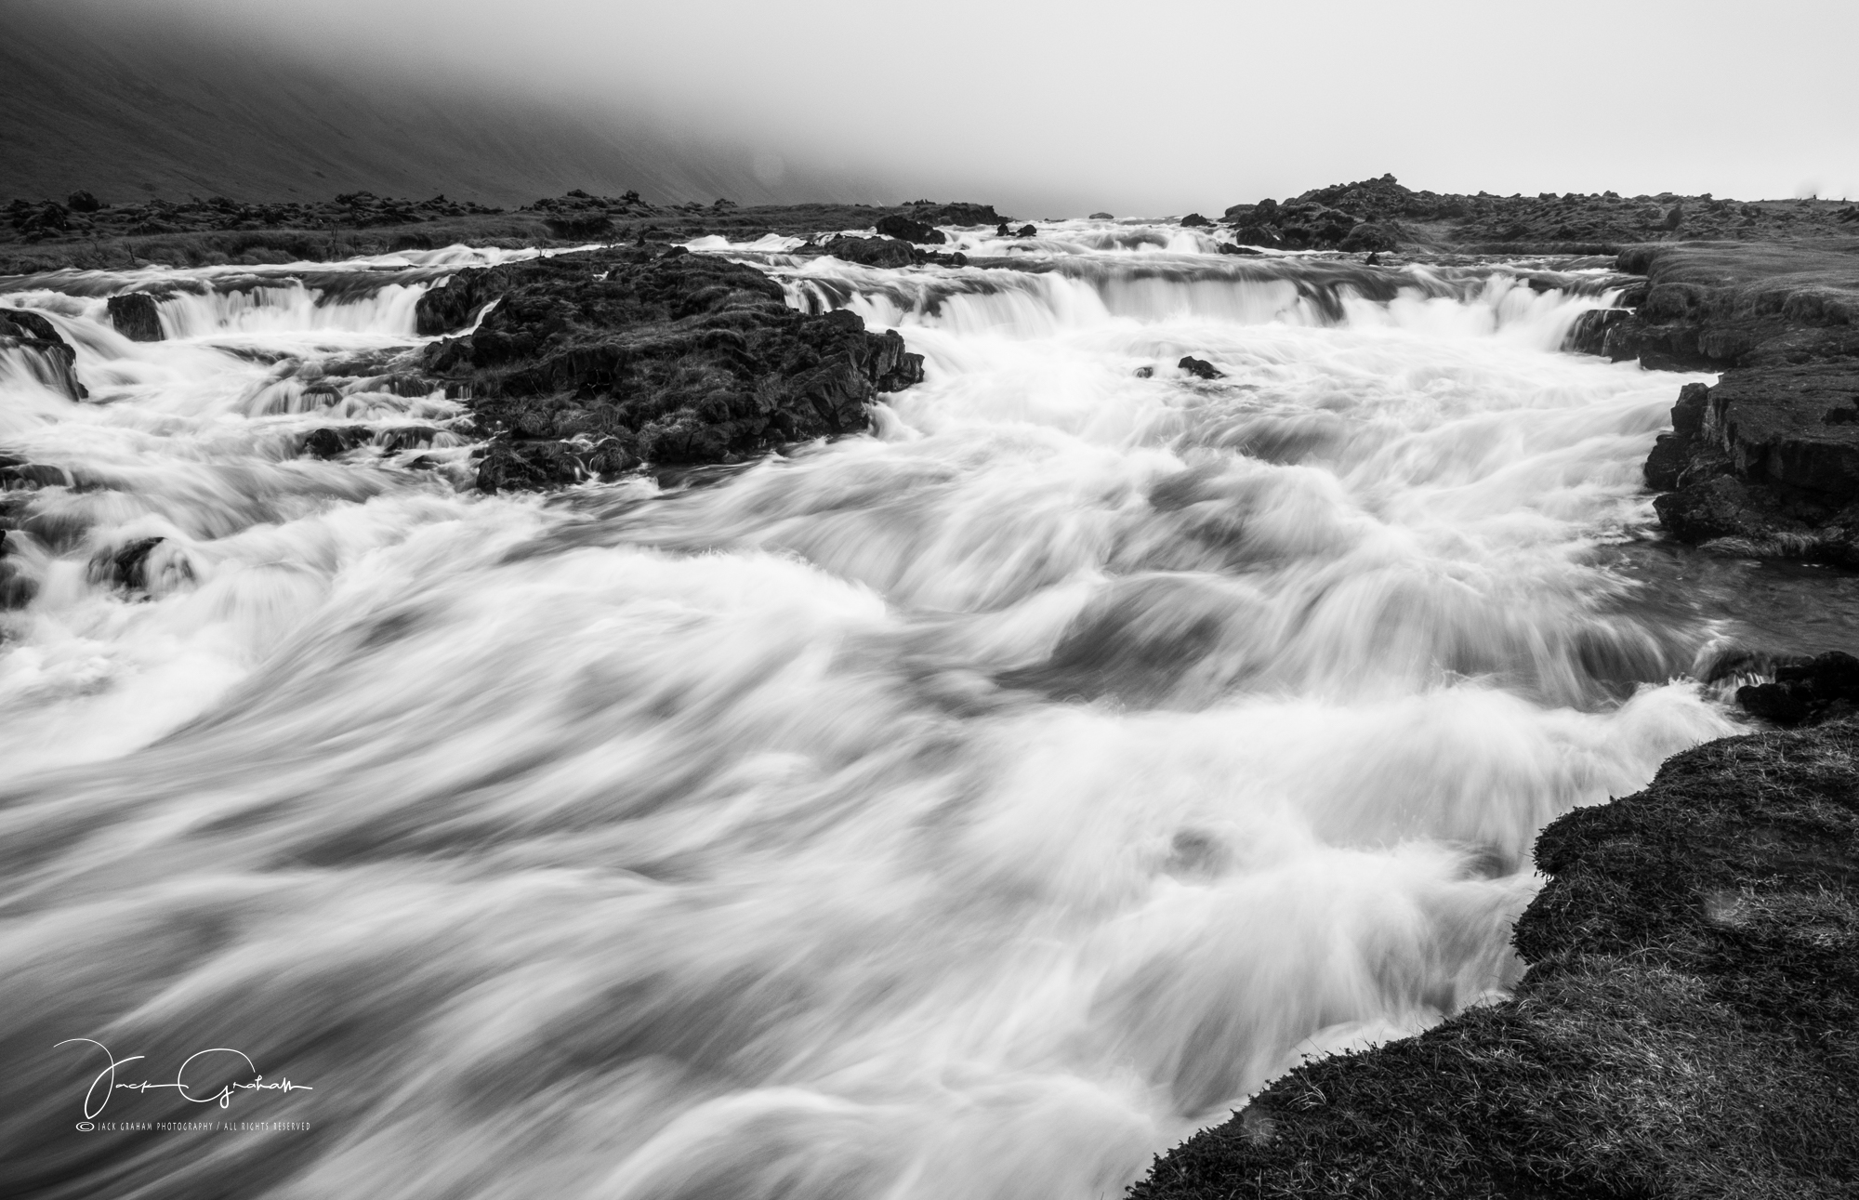

Slide 17
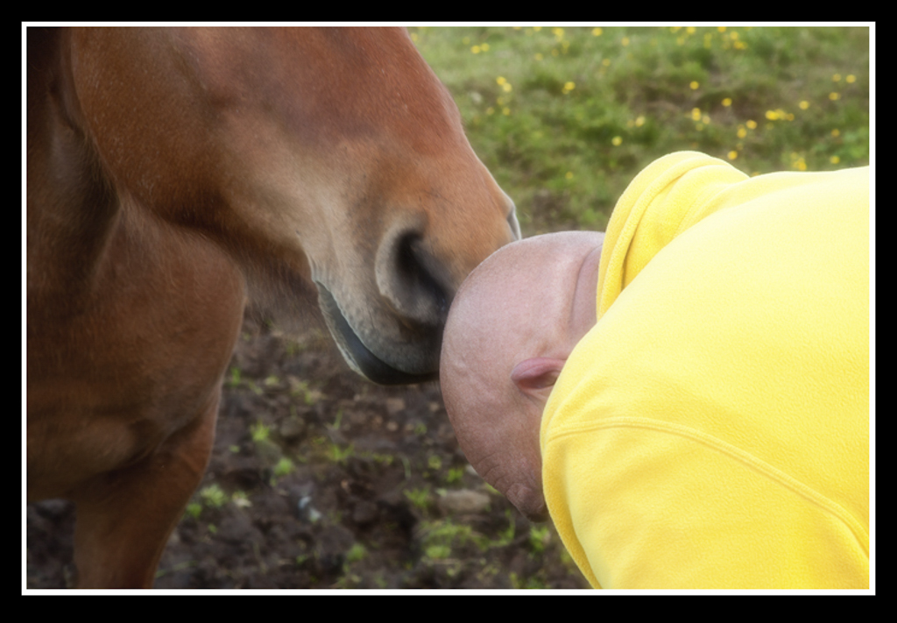

Slide 18
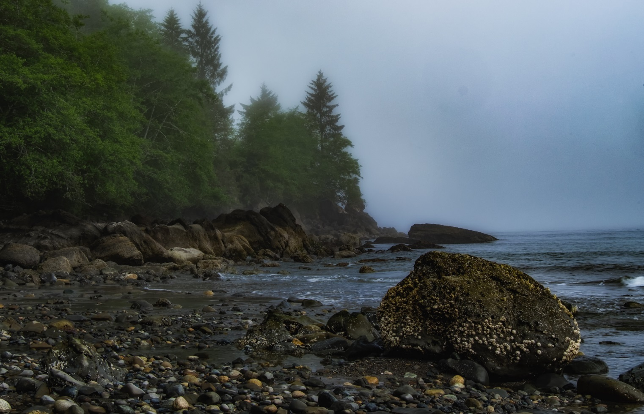
MAKE YOUR IMAGES PERSONAL…….
Develop a relationship with the place
This will mean more after time…go back, back ….back
LET THE PLACE INSPIRE YOU …….
Rather than you attempting to inject your own sensibilities into it.

Slide 19
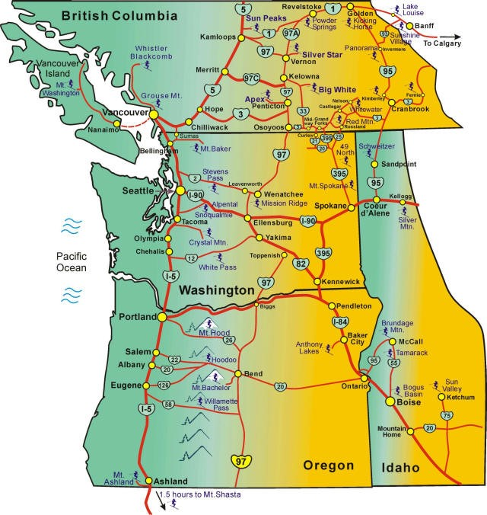

Slide 20
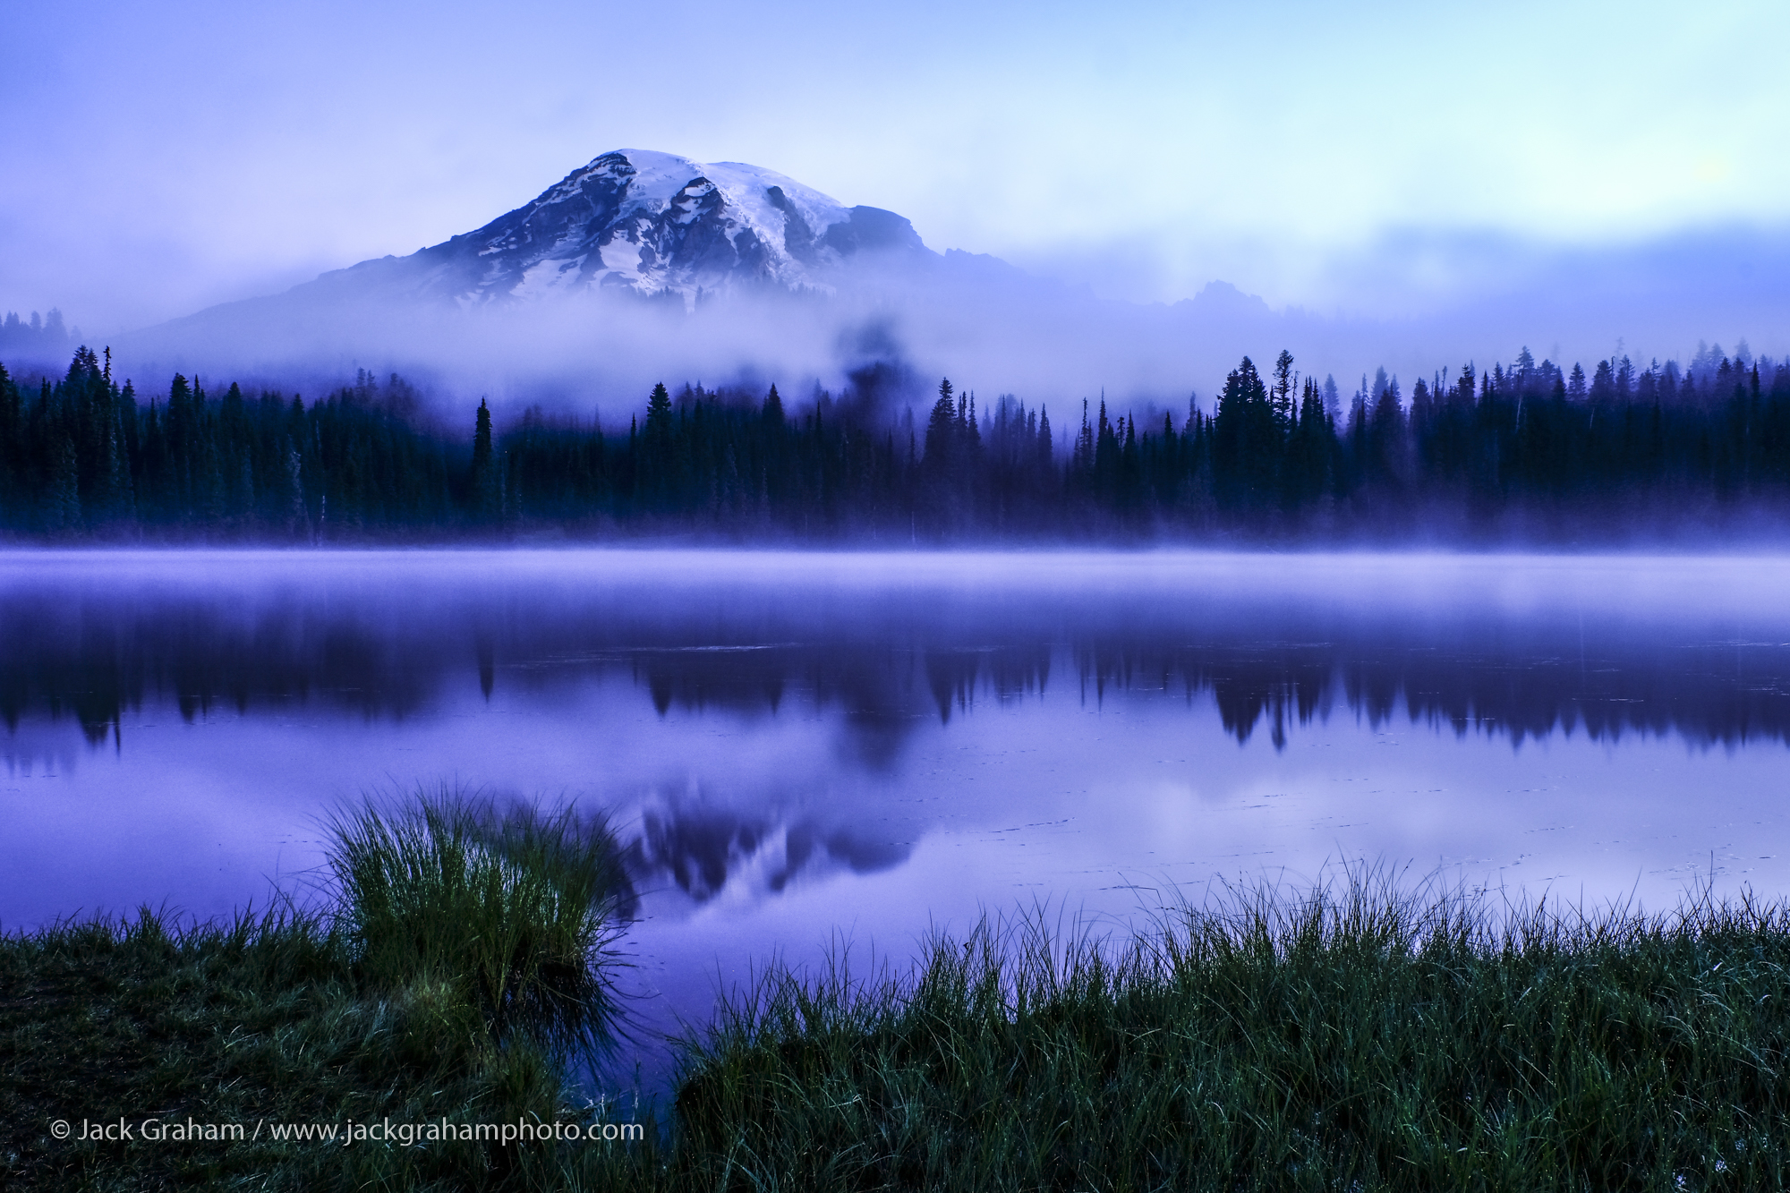

Slide 21
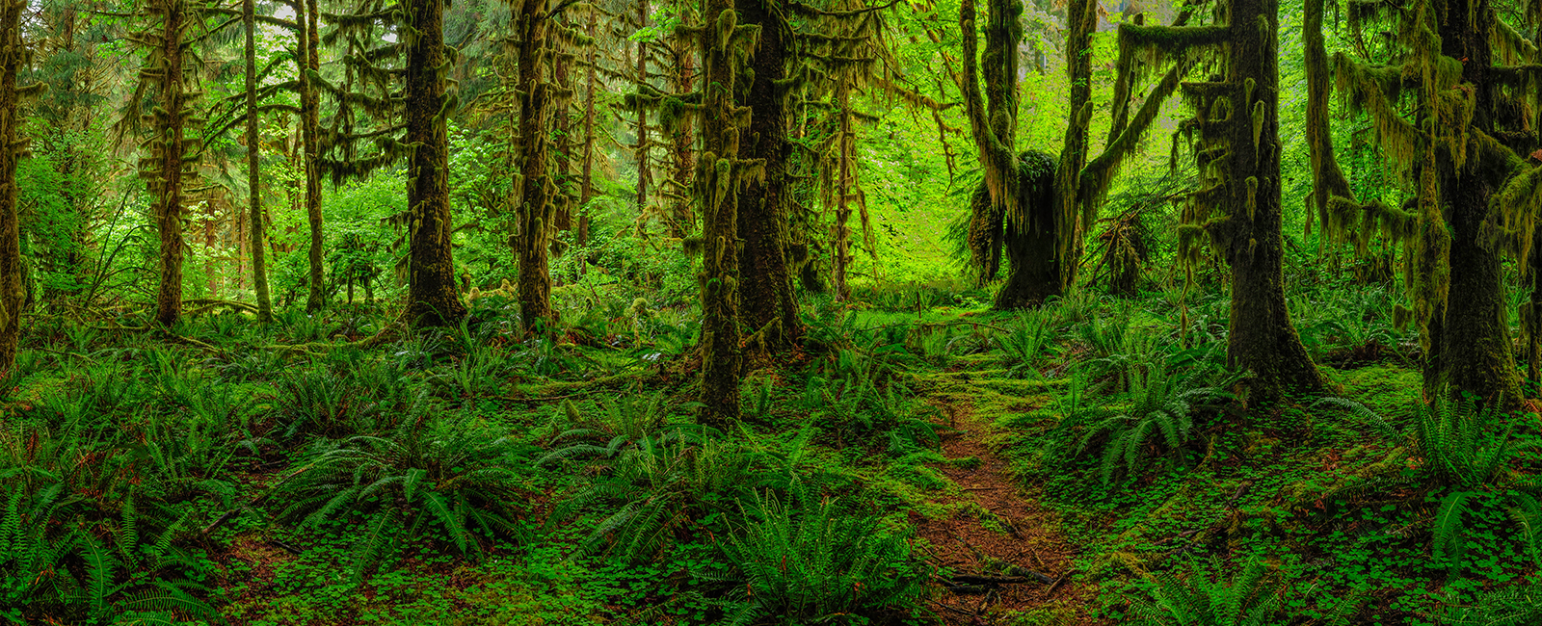

Slide 22
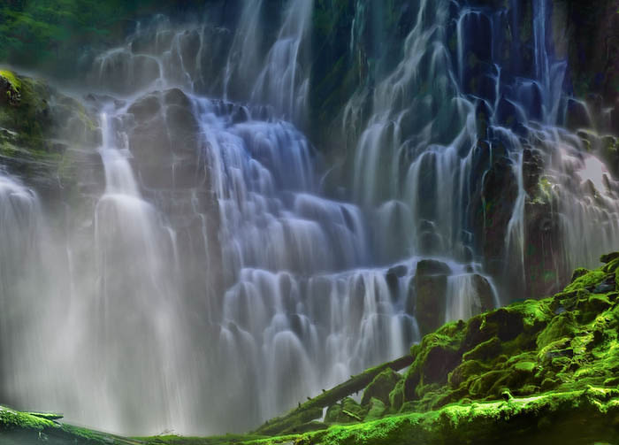

Slide 24
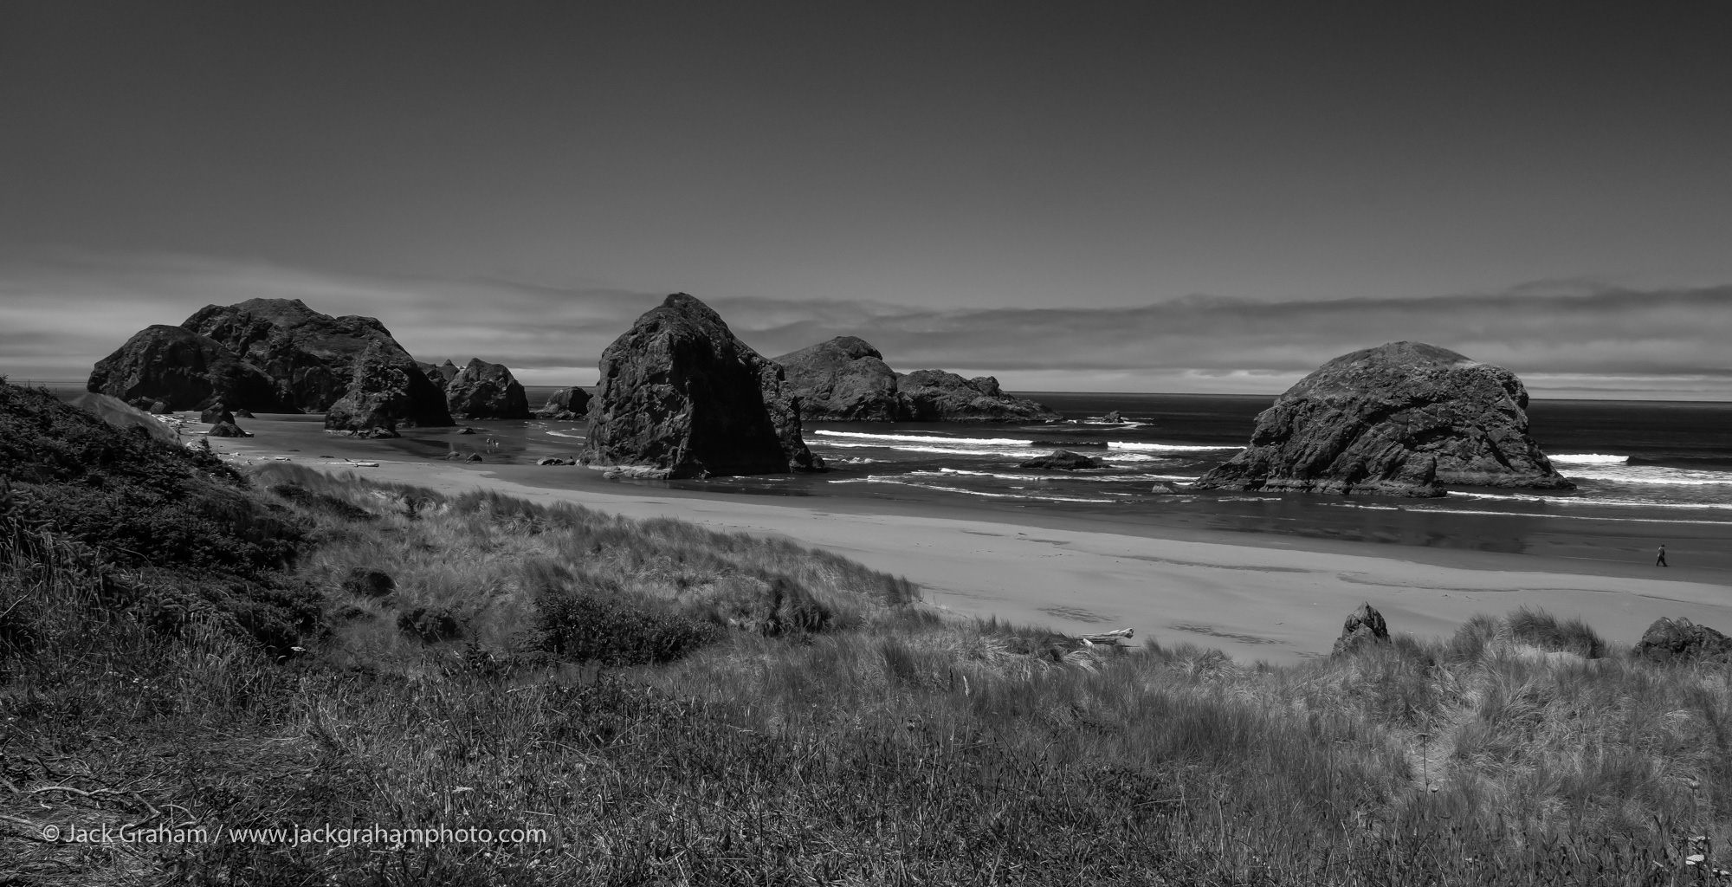

Slide 25
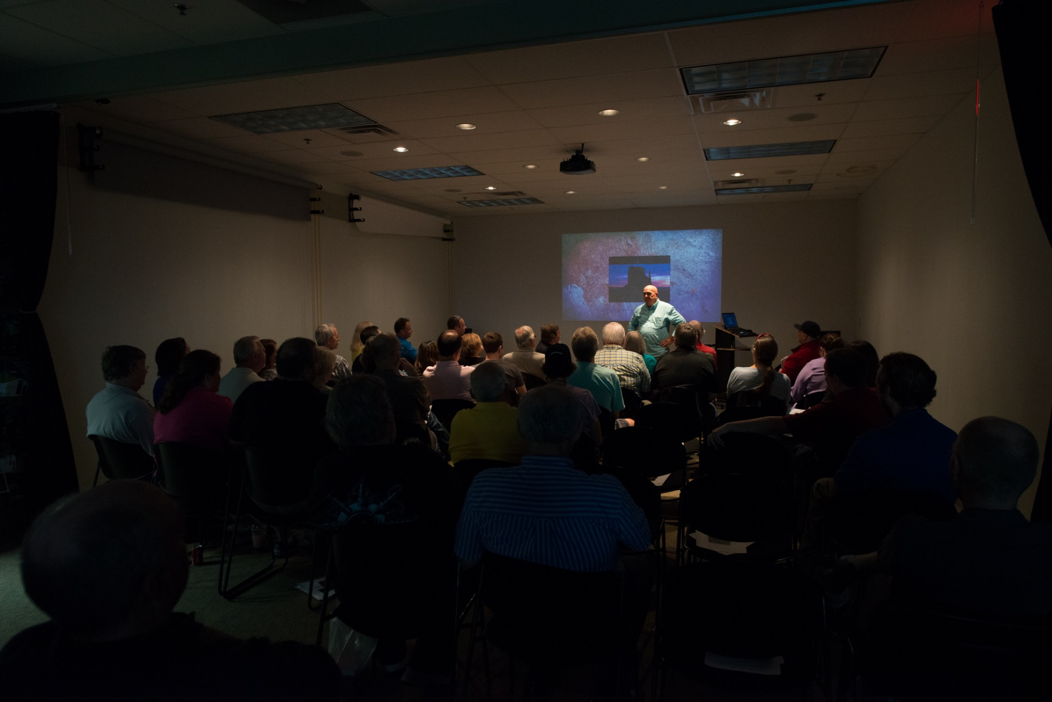

Slide 26
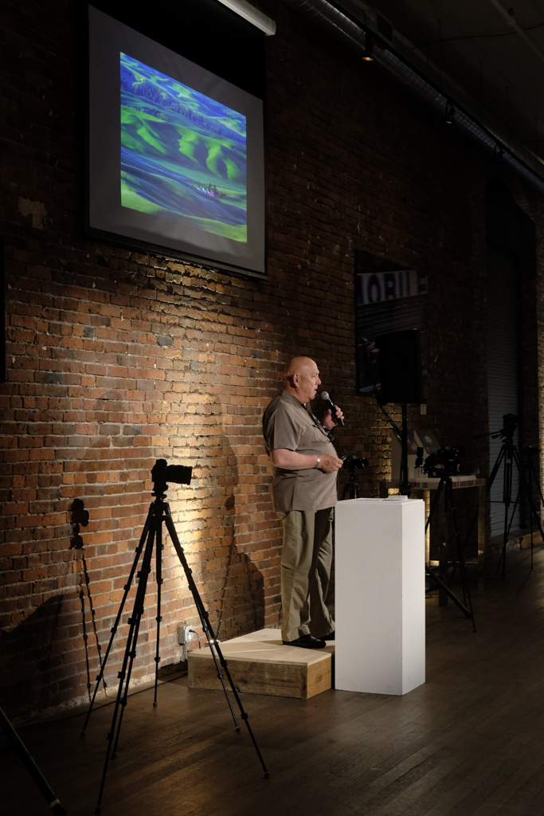

Slide 27
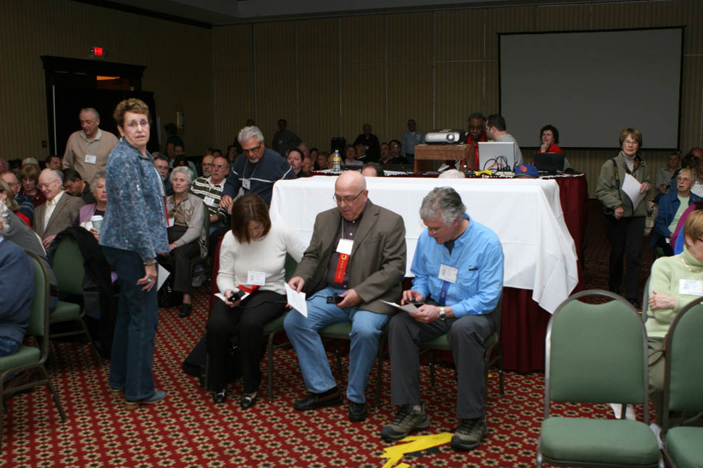

Slide 28
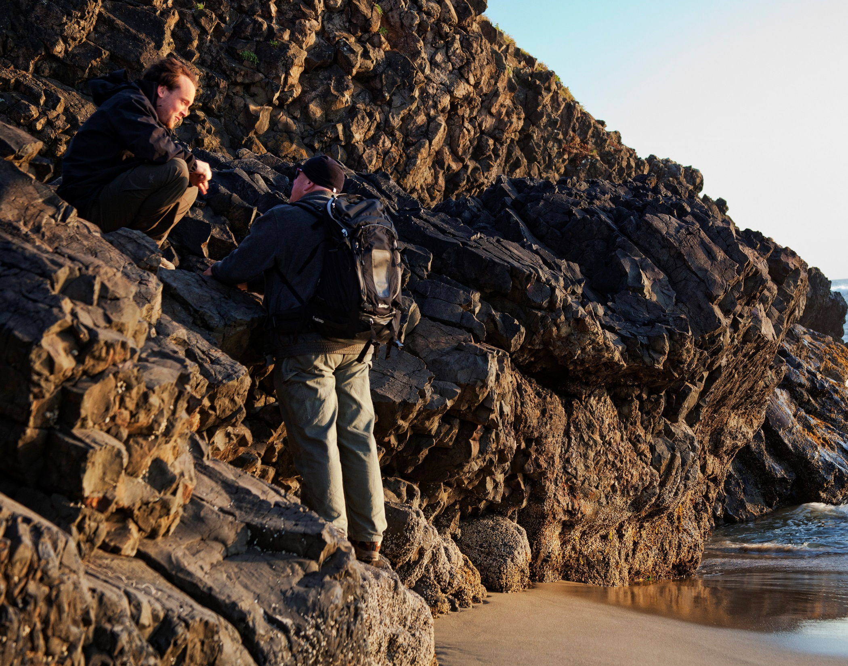

Slide 29
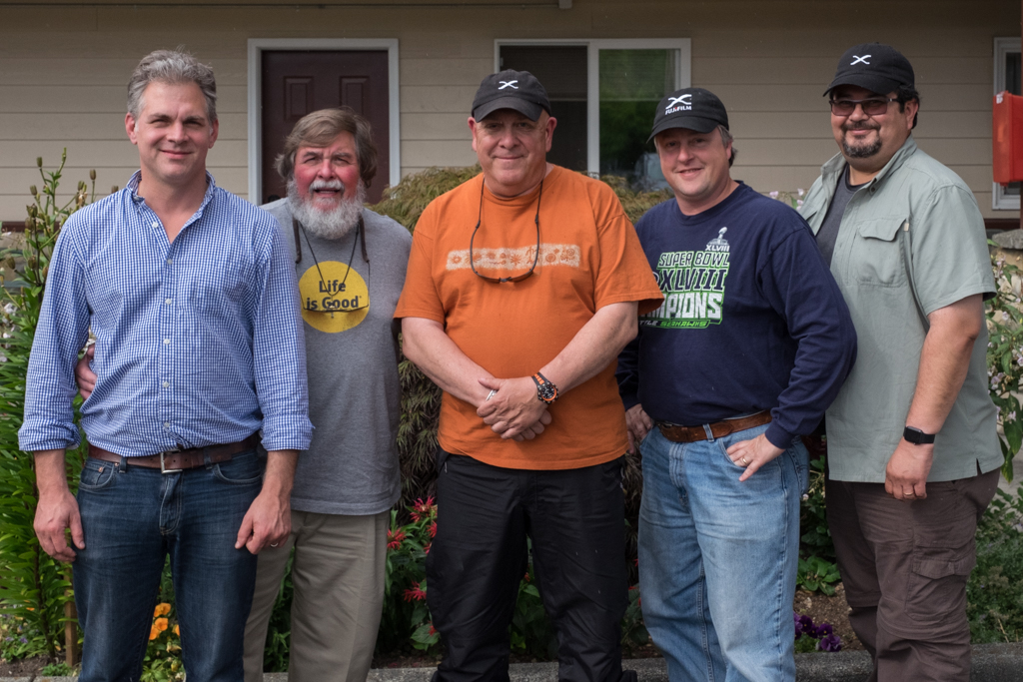

Slide 30
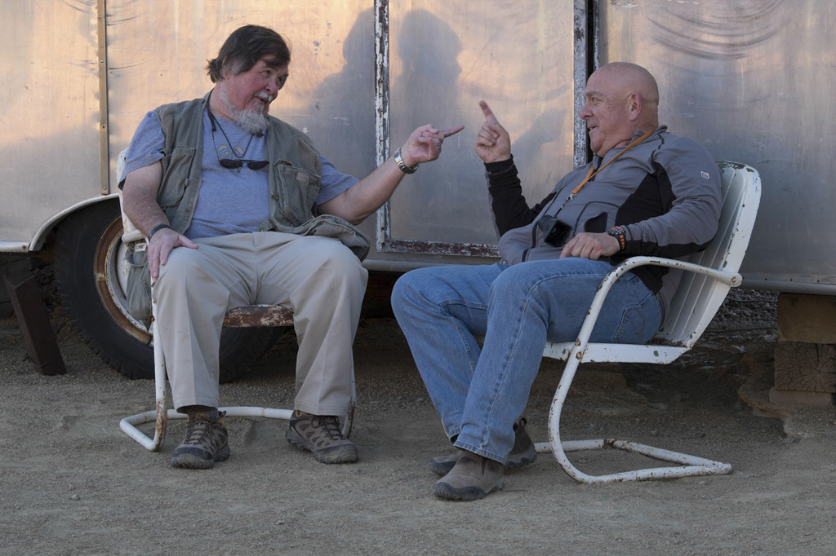

Slide 31
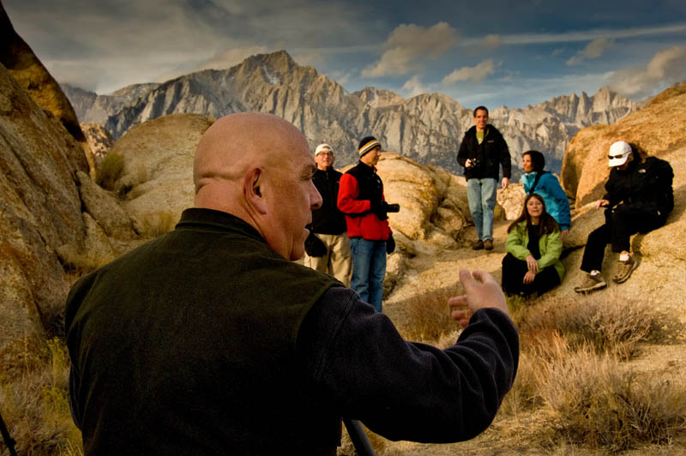

Slide 32
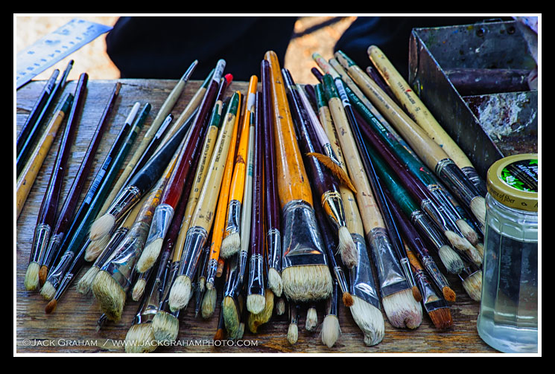
THE ART of BECOMING an ARTIST

Slide 33
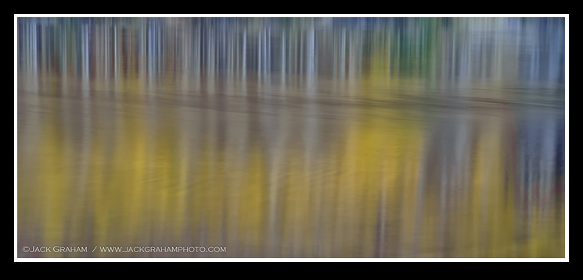
“Photographers who come up with power never get accused of imitating anyone else even though they photograph the same broom, same street, same portraits.” -Minor White

Slide 34
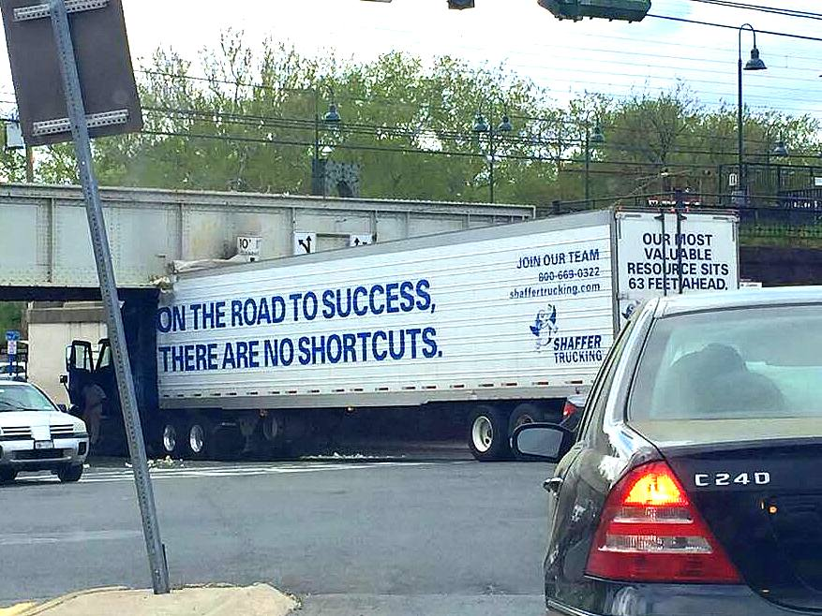

Slide 35
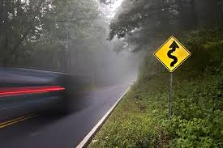
TIME
TIME MANAGEMENT

Slide 36
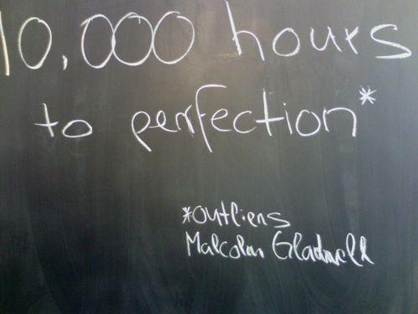
“Getting Good”
40 hrs. x 50 weeks x 5 years = 10,000 hrs.

Slide 37
“One does not think during creative work, any more than one thinks when driving a car. But one has a background of years —learning, unlearning, success, failure, dreaming, thinking, experience, all this—then the moment of creation, the focusing of all into the moment.”…Edward Weston
TIME MANEMENT (in the business world) is sometimes refer to as a strategy for increasing productivity.. using time in the most efficient way.
Today we are not raised to become creative individuals… we are raised to become productive people in society.
Some of us constantly struggle with making the most of our time….getting the most out of a rewarding experience.
In art, the proper management of time can sometimes mean the exact opposite of what it means within a business context.

Slide 38
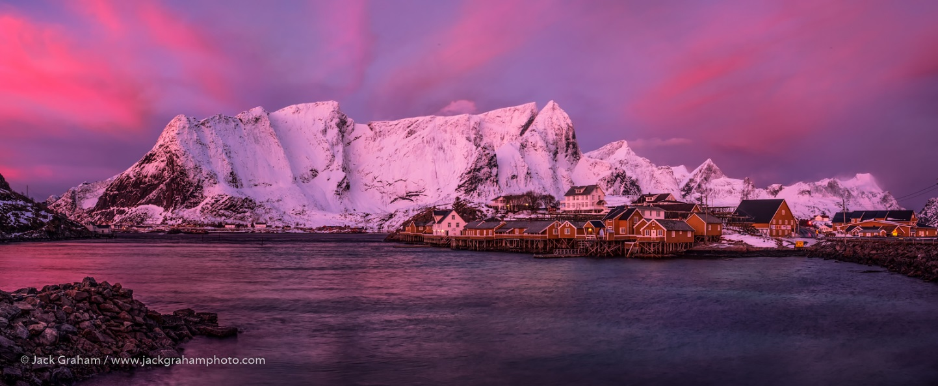
Photographers sometimes find themselves at a disadvantage when it comes to investing time.
Often we are obsessed with short-lived decisive moments, neglecting to acknowledge that these moments are far more meaningful when considered the top of the mountain of a great experience

Slide 40
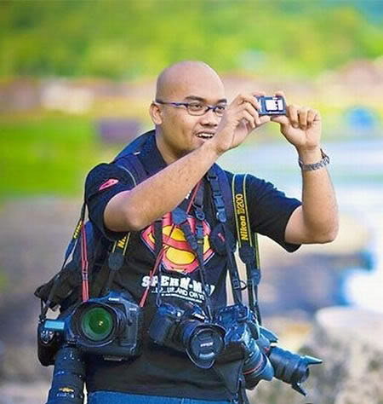
In addition, the camera manufactures do a great job telling us that we are better off when things are easier, faster, more automated and requiring less thinking and creativity.

Slide 41
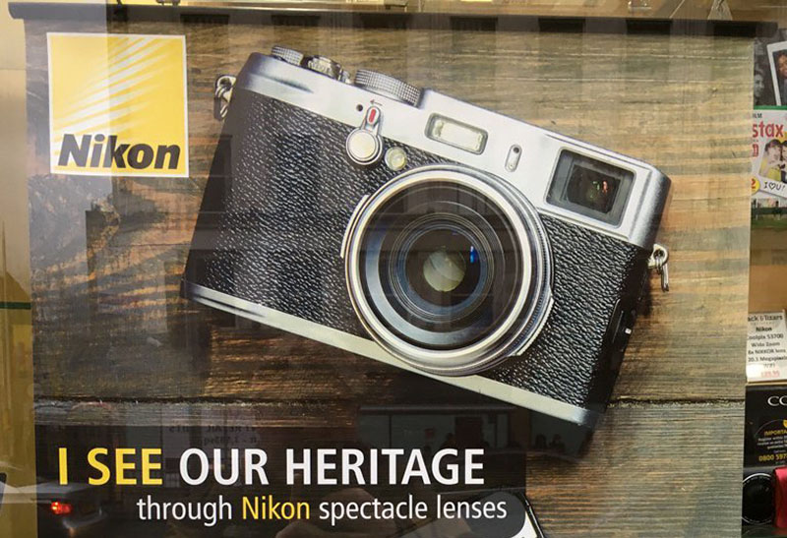

Slide 42
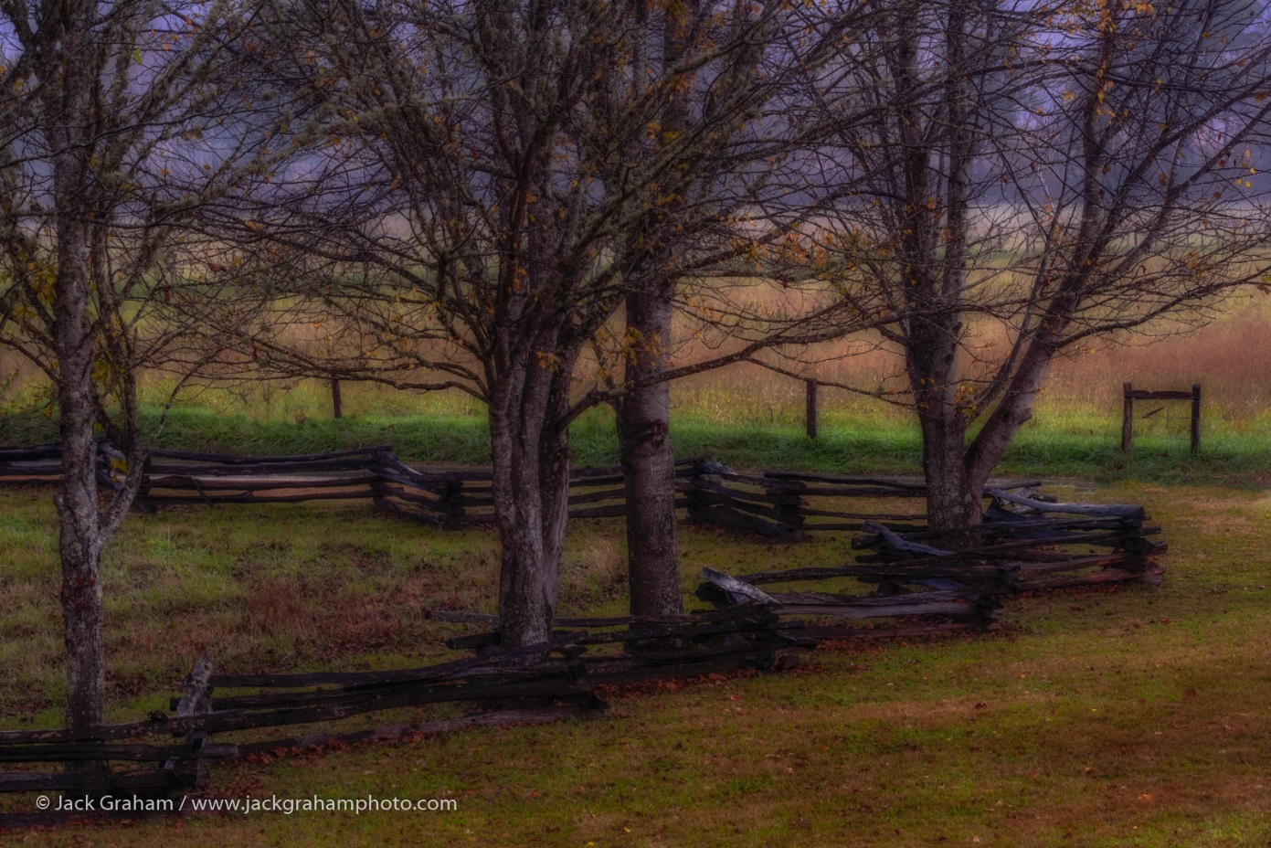
Lots of Photographers fall for this without even realizing the greater satisfaction that can be found in the “Art” of making the image. And in slowing down and thinking, then going back home with not just a photograph but also with a memory of an experience worthy of recalling in the years to come.

Slide 43
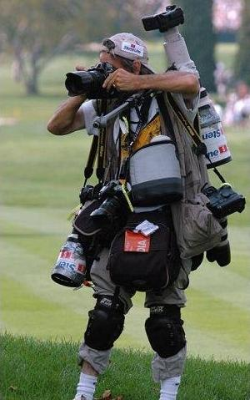
EQUIPMENT
NOT !!!!!!!

Slide 44
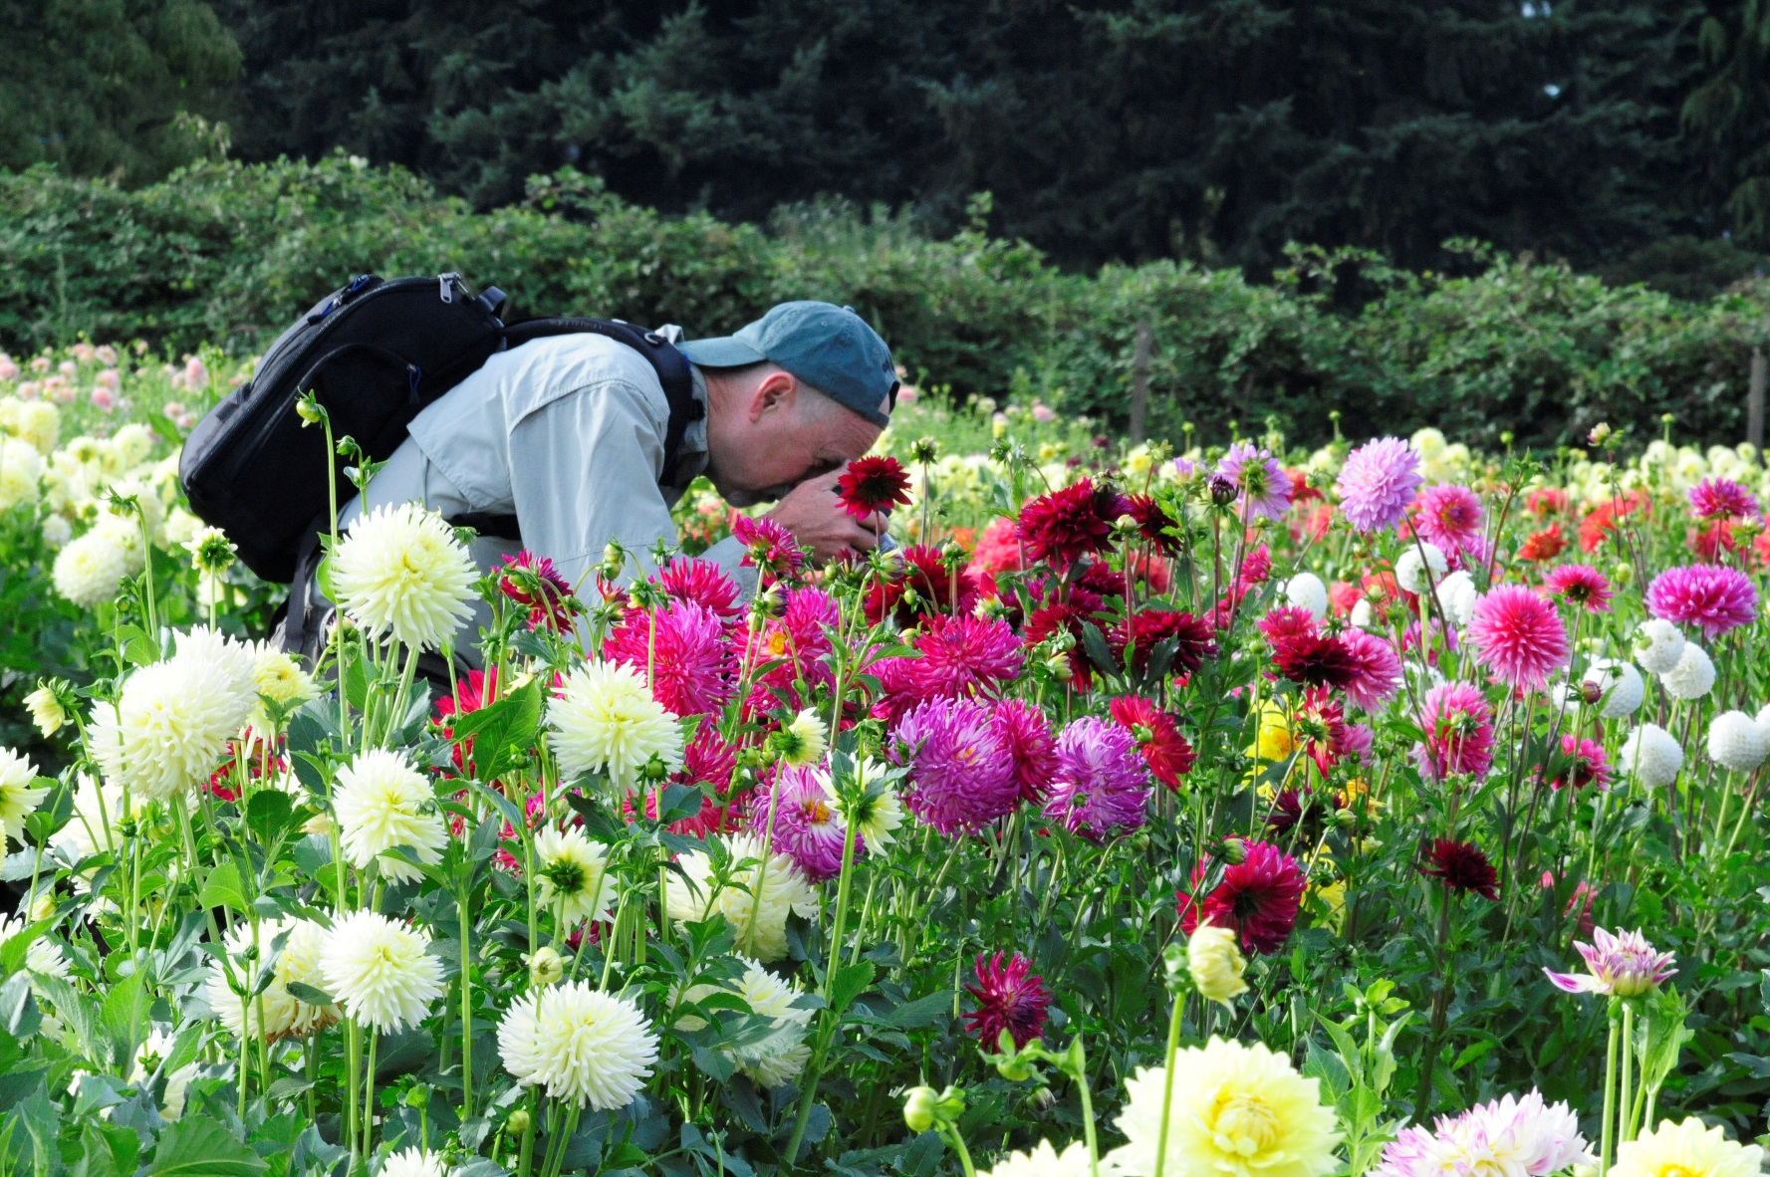
IT’S YOU !!!!

Slide 45
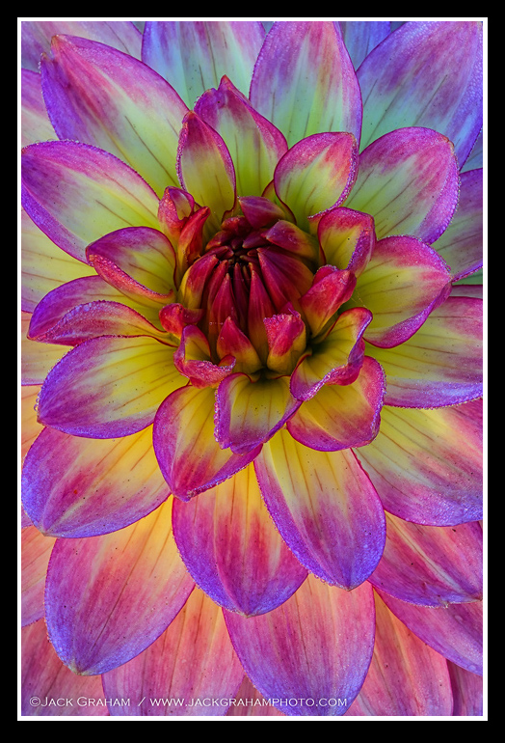

Slide 46
Creativity …… the pursuit of bringing something new into existence
Fine Art “creative” photography is about the expression of :
> Subjective ideas
Emotions and
Sensibilities through the beauty of natural elements
A creative photograph is the result of venturing beyond the act of pressing the shutter and recording a scenes and objects with a camera.
Rather than thinking about what you want your viewers to see when looking at your work, think instead about how you want to inject yourself into the image.
the pursuit of bringing something new into existence
Fine Art “creative” photography is about the expression of :
> Subjective ideas
Emotions and
Sensibilities through the beauty of natural elements
A creative photograph is the result of venturing beyond the act of pressing the shutter and recording a scenes and objects with a camera.
Rather than thinking about what you want your viewers to see when looking at your work, think instead about how you want to inject yourself into the image.

Slide 47
> While in the field, try to think beyond how you may normally see
the scene in front of you.
> Your brain is programmed to use visual information in various ways.
At times, the creative opportunities may not be obvious
unless deliberately sought.
> A creative image is first formed in the mind’s eye before being
captured by the camera.
> Beyond mere technical considerations, be deliberate about framing
and composition decisions.
……And above all, strive to get to a place where you
believe in your own ability to make great images.

Slide 48
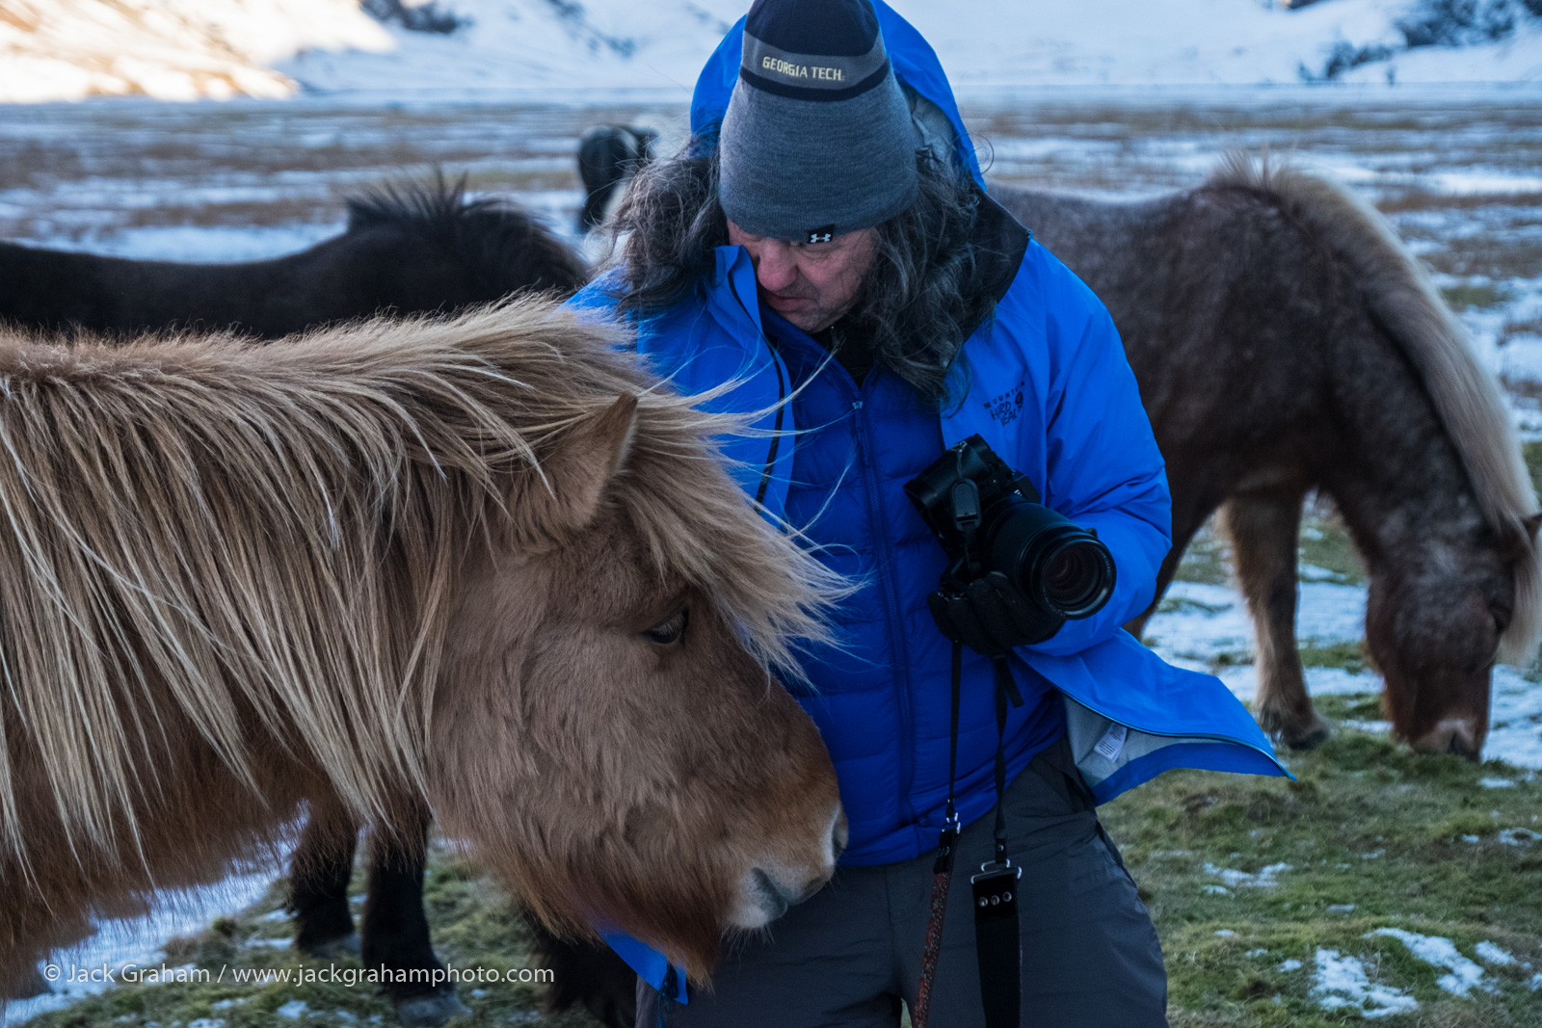
SLOW DOWN…enjoy the experience!

Slide 49
LOVE WHERE YOU ARE
PHOTOGRAPH FOR THE ART
PHOTOGRAPH FOR THE EXPERIENCE

Slide 50
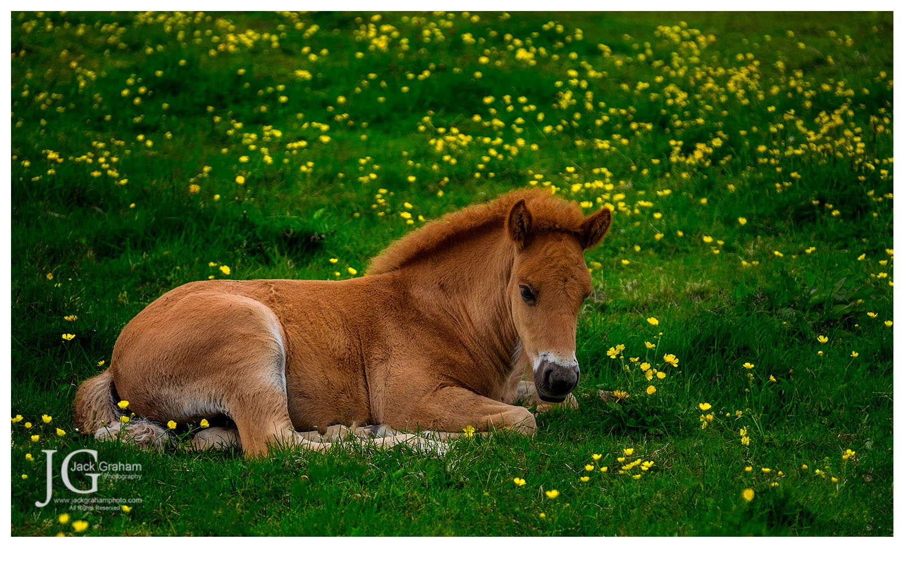
SIMPLIFY

Slide 51
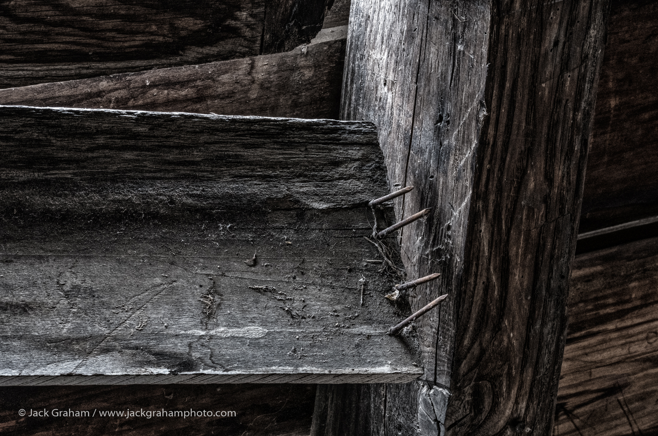

Slide 52
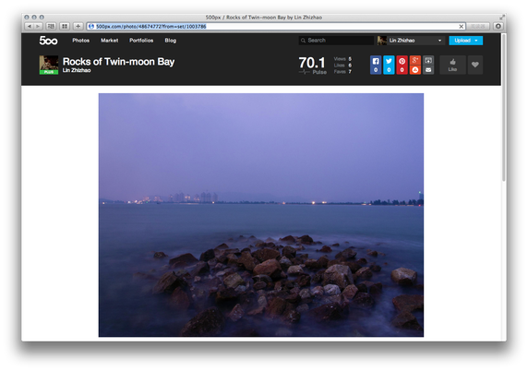
TODAY’S SOCIAL MEDIA and its INFLUENCES ON BECOMING an ARTIST
The need for acceptance, validation are innate to humans
We are “programmed” to want to feel good about such things
Greater rewards come from being creative, discovery and self expression
It’s important to balance socializing and popularity with your inner rewards of creativity and self expression
Artist should have the motivation, courage and will power to provide the effort it takes to accomplish the task of becoming a true artist.

Slide 53
We saw photographs we want(ed ) to make ourselves
Copying others images served us well in developing technique and the way we communicate(ed) visually.
NOW…. For a change in priorities ! THE NEXT LEVEL
Strive to get to a point that the need for self expression exceed the need for learning more techniques and mimicking others.
Without attaining this level, you can not grow as an artist and your work will stay at the same level….
You become more dependent on validation, popularity, awards ETC…..
Most do not recognize that they are seeking the “NEXT LEVEL”
The “NEXT LEVEL” is attained by changing your attitude and using your knowledge in a more personal way and telling you own stories.
THE NEXT LEVEL

Slide 54
There is no such thing as THE way.
There is only for each individual, his or her way, which at the end…, each one must find for himself or herself in photography.
“Your photography is a record of your living, for anyone who really sees. You may see and be affected by other people’s ways, you may even use them to find your own, but you will have eventually to free yourself of them.”…….Paul Strand

Slide 55
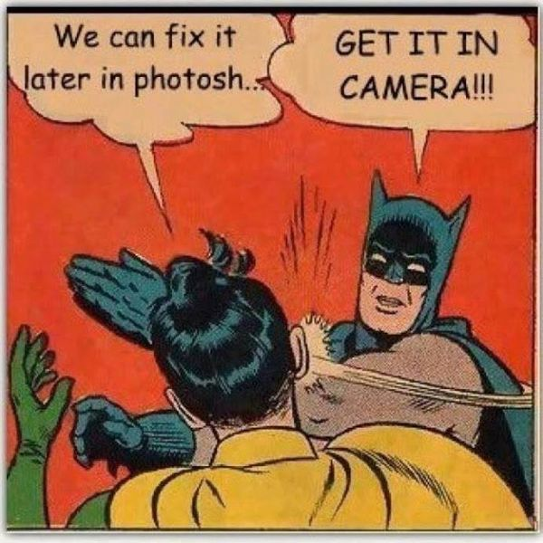

Slide 56
Having said that……
I love Lightroom, Photoshop, Nik etc.
TOOLS OF THE TRADE!

Slide 57
But….To ME…The “Art” is trying to get it right in the camera!

Slide 58
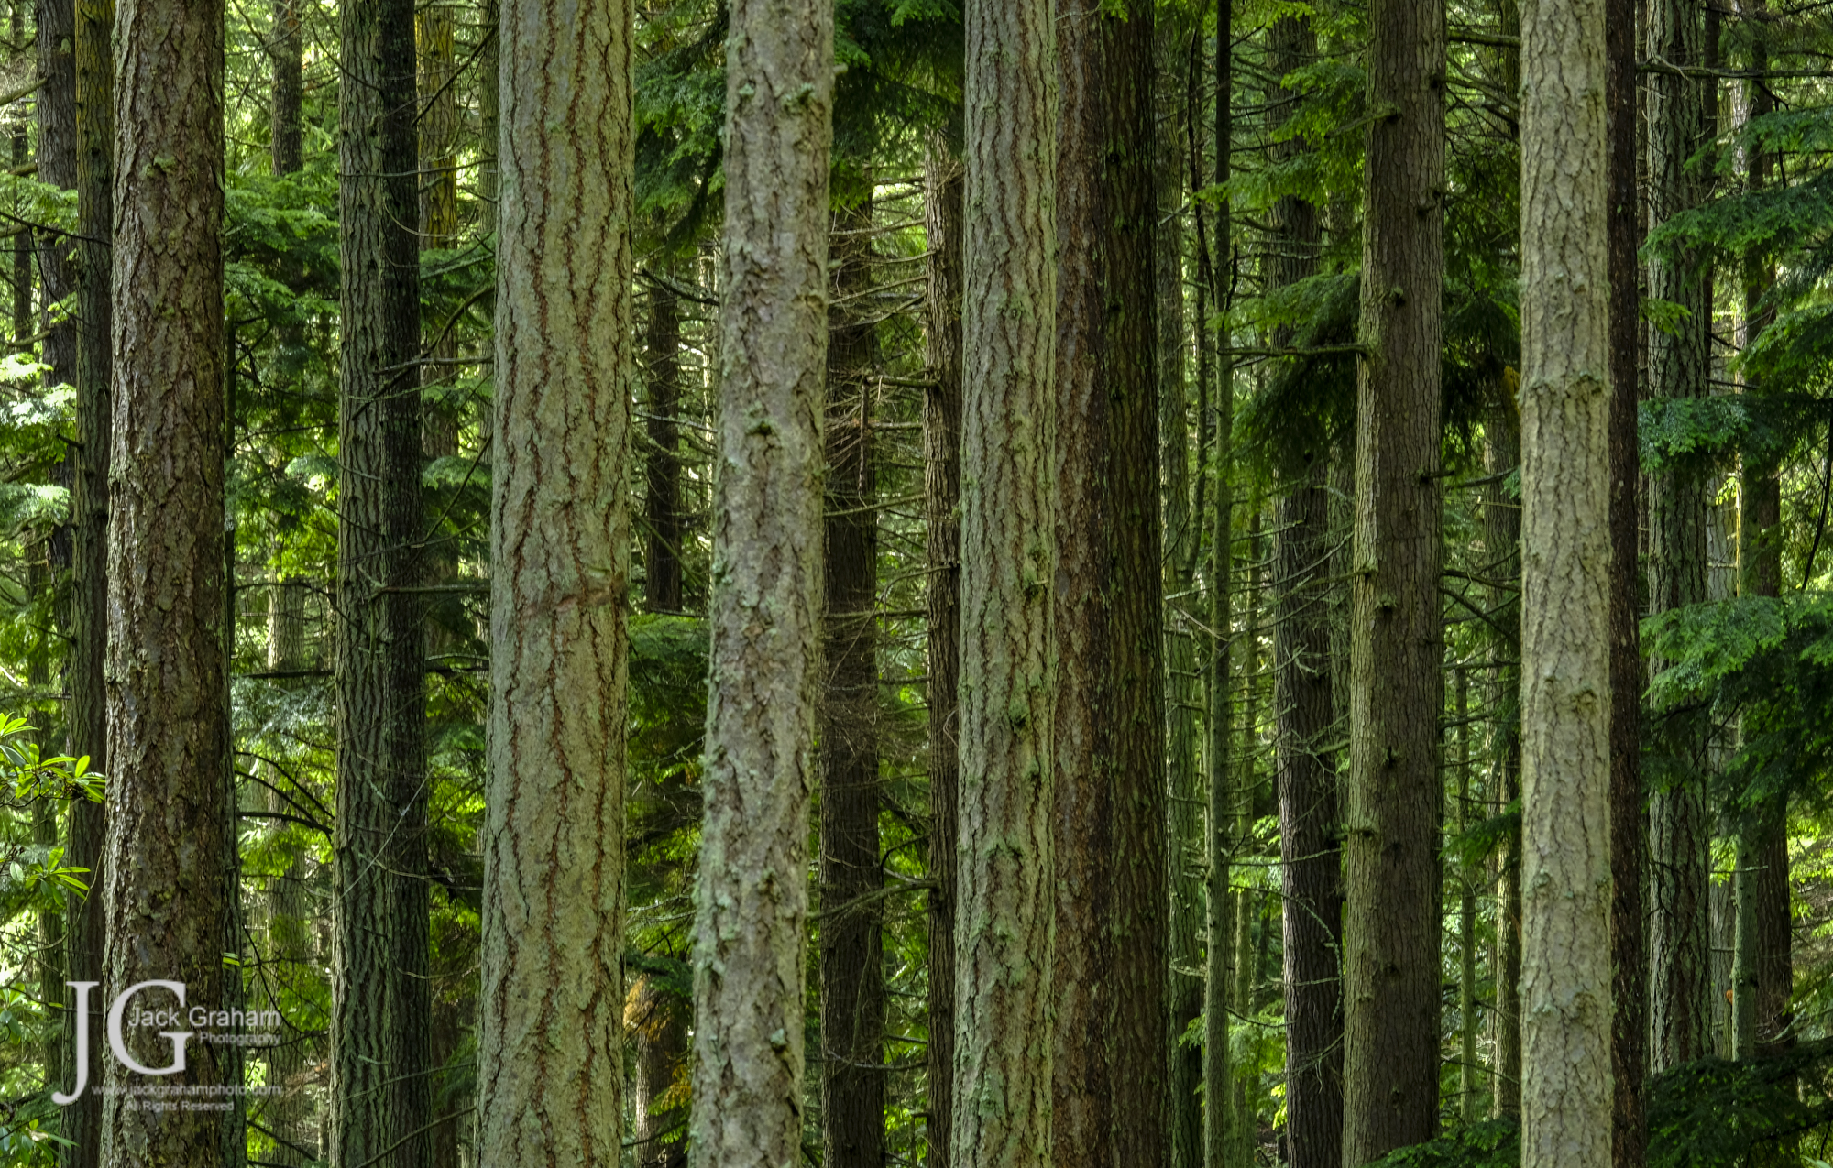

Slide 59
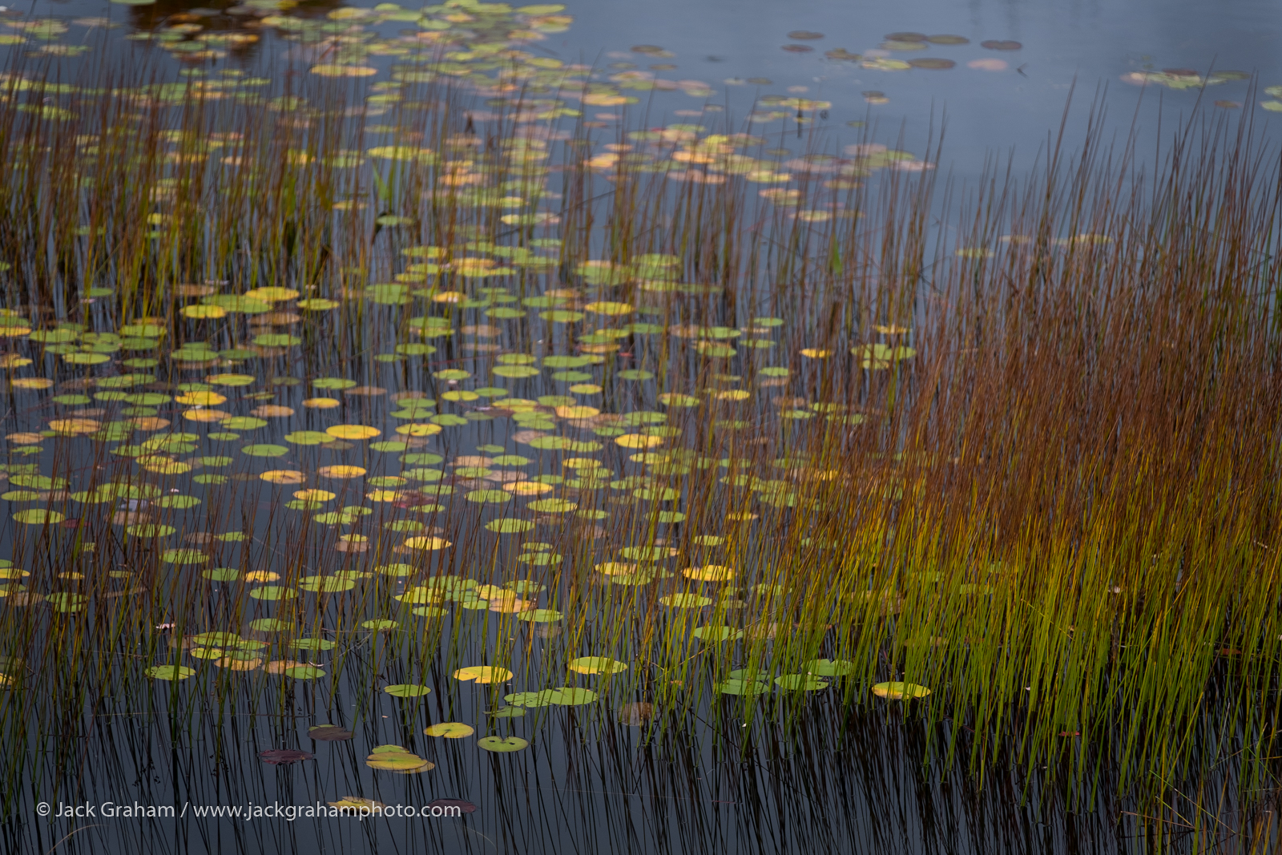

Slide 60
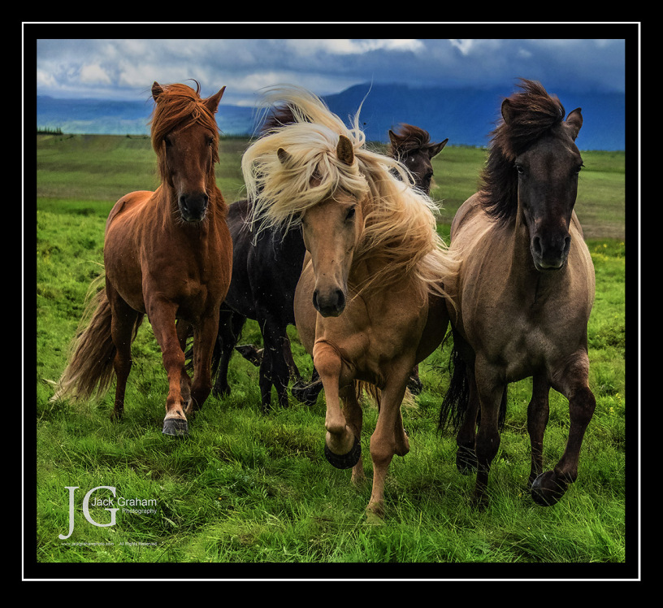
VALIDATION….Yes we need this too !
Consider the source
Learn from your mistakes. We all make them
You never stop growing and learning
You are NOT alone !

Slide 61
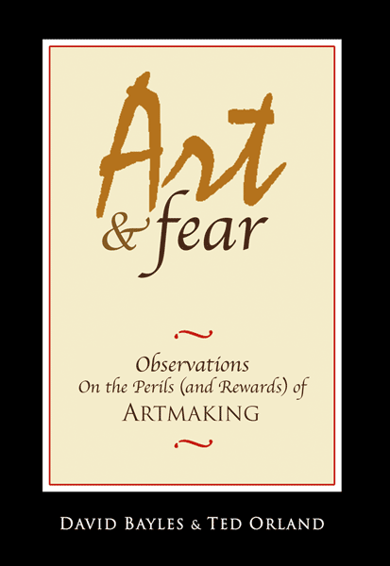
Don't get consumed with getting rich and famous…get good and you will be found!

Slide 62
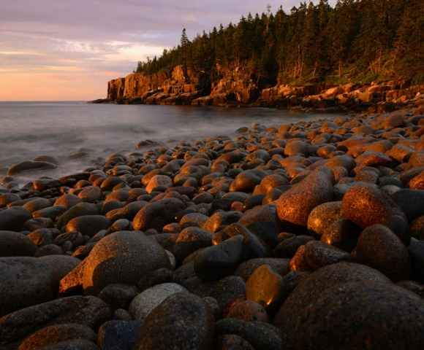
www.jackgrahamsblog.com

Slide 63
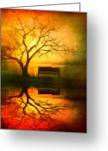
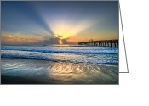

Slide 67
While becoming an artist….Certainly, failure is a very real possibility and you should be at peace with it, and prepared to regroup and go on if it happens…..
“There is no comparison between that which is lost by not succeeding and that which is lost by not trying.”
…. Francis Bacon

Slide 68
SO.... WHAT’S IT ALL ABOUT?..................
It’s about becoming an artist, not just a photographer. Enjoy the journey… enjoy life…enjoy all the being an artist will do for YOU !
THANK YOU ALL FOR COMING!!!
©Jack Graham Photography LLC/ All Rights Reserved / All Images made using Fujifilm Cameras and Fujinon Lenses v91210169_

